Slide 1




Agile 12 Principles
In this presentation, we will explore the 12 principles of Agile, understand the Agile mindset, and learn how these principles enhance collaboration and productivity.
by vijay kumar

Slide 2

Agile Principles for Software Development
Customer Satisfaction: Our highest priority is to satisfy the customer through early and continuous delivery of valuable software. Example: A software team releases a basic version of an app for user feedback. Iteratively, they add features based on customer suggestions, ensuring ongoing satisfaction.
Welcome Change: Welcome changing requirements, even late in development. Agile processes harness change for the customer's competitive advantage. Example: A product team adapts to new market trends, modifying their e-commerce platform to incorporate the latest payment methods.
Frequent Deliveries: Deliver working software frequently, with a preference for the shortest timescale. Example: A software team completes and delivers functional updates to an online learning platform every two weeks, ensuring continuous improvements.
Collaboration: Business people and developers must work together daily throughout the project. Example: Continuous interaction between developers and stakeholders ensures alignment on project goals and avoids misinterpretations.
Supportive Environment: Build projects around motivated individuals. Give them the environment and support they need and trust them to get the job done. Example: Empowering teams with decision-making authority encourages ownership and boosts productivity.
Face-to-Face Conversations: The most efficient and effective method of conveying information to and within a development team is face-to-face conversation. Example: Regular in-person meetings among team members promote better understanding and quicker issue resolution.
Progress Measurement: Working software is the primary measure of progress. Example: Tracking progress based on functional software delivered rather than solely on tasks completed ensures tangible value.
Sustainable Pace: Agile processes promote sustainable development. The sponsors, developers, and users should be able to maintain a constant pace indefinitely. Example: Avoiding burnout by maintaining a steady, sustainable workflow throughout the project duration.
Continuous Excellence: Continuous attention to technical excellence and good design enhances agility. Example: Regular code reviews and refactoring sessions ensure high-quality software and maintainability.
Simplicity: Simplicity—the art of maximizing the amount of work not done—is essential. Example: Developing the simplest solution to meet immediate needs avoids unnecessary complexity.
Self-Organization: The best architectures, requirements, and designs emerge from self-organizing teams. Example: Empowered teams organize themselves, select their methods, and collaborate effectively to deliver value.
Reflect and Adjust: At regular intervals, the team reflects on how to become more effective, then tunes and adjusts its behavior accordingly. Example: Conducting retrospectives after each sprint allows teams to identify improvement areas and implement changes for better efficiency.
Discover the 12 principles that guide the ethical development and use of Artificial Intelligence. Learn how these principles promote fairness, transparency, and accountability in AI systems, ensuring the responsible and beneficial application of this powerful technology.
Agile Principles
1
Iterative Development
2
Customer Collaboration
Deliver software incrementally, allowing for flexibility and continuous improvement.
Involve the customer throughout the development process to ensure their needs are met.
3
Self-Organizing Teams
4
Continuous Feedback
Empower teams to make decisions, foster strong collaboration, and embrace shared responsibility.
Regularly gather feedback from customers, stakeholders, and team members to drive improvement.

Slide 3

Understanding Agile
1
Embrace Change
Adapt and respond to changing requirements and customer needs.
Value Individuals and Interactions
2
Prioritize effective communication and collaboration within the team.
3
Working Software Over Documentation
Focus on delivering functional software that provides value to the customer.

Slide 4

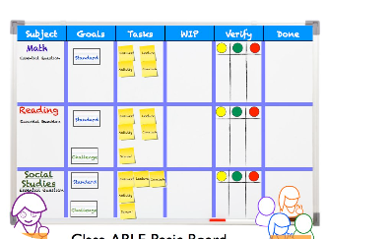
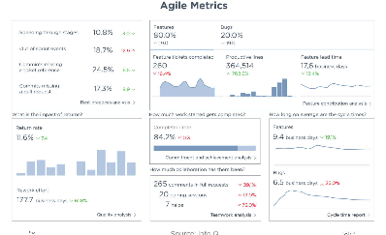
Collaboration and Productivity
Efficient Teamwork
Visual Work Tracking
Measurable Improvement
Seamless collaboration and communication drive increased productivity.
Utilize agile boards to enhance transparency, accountability, and progress tracking.
Implement metrics and continuous monitoring to identify areas of improvement.

Slide 5
Practical Application of Agile
Agile Methodologies
Agile Practices and Tools
Explore popular methodologies such as Scrum, Kanban, and Lean.
Discover key agile practices and the tools that support effective implementation.
Case Studies
Q&A Session
Learn from successful companies that have embraced Agile and see their impressive results.
An opportunity to ask questions and dive deeper into agile methodologies and best practices.

Slide 6
Key Benefits of Agile
1
Flexibility & Adaptability
Quickly respond to changing market demands and customer feedback.
Improved Quality
2
By embracing continuous improvement and feedback loops, quality is always a priority.
3
Customer Satisfaction
Engaging customers throughout the process ensures their needs are met, leading to higher satisfaction.

Slide 7
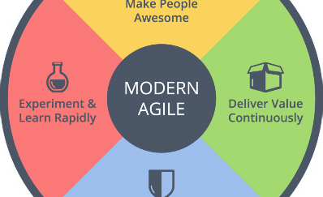


The Agile Mindset
Iterative Thinking
Continuous Learning
Agile Values
Embrace an iterative and incremental approach to problem-solving.
Cultivate a learning culture where individuals and teams are open to experimentation and improvement.
Build an environment that values collaboration, trust, transparency, and adaptability.

Slide 8
Reaping the Benefits
1
Increased Speed to Market
2
Higher Team Morale
Agile practices enable faster product delivery and quicker response to market changes.
Self-organizing teams, clear goals, and regular feedback boost morale and job satisfaction.
3
Adaptive Planning
4
Business Agility
Agile planning allows for adjustments and course corrections based on real-time insights.
Agile organizations are better equipped to navigate uncertainty and seize new opportunities.

